Slide 1

Breaking Down Complex Systems with RabbitMQ
Erie Web Development Group
July 23, 2014
Eric Kepes

Slide 2
What is RabbitMQ?
A Message Broker
Cross-platform
Implements AMQP standard
Open Source (MPL)
Built on Erlang

Slide 3
Why Messaging?
Allows a system to be broken into parts
Facilitates reliable background work
Enables scaling out
Provides a way to recover from/work around outages

Slide 4
Why Break Up?
Separate Concerns
Scale Out
Spread Out Work
Facilitate Newer Deployment Models

Slide 5

Installing RabbitMQ
Install Erlang
http://www.erlang.org/download.html
Install RabbitMQ
http://www.rabbitmq.com/install-windows.html

Slide 6
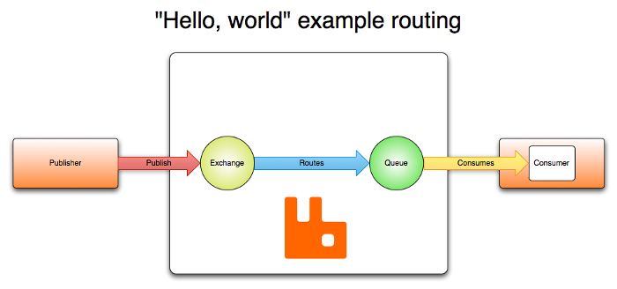
Parts of RabbitMQ
Publishers
Exchanges
Routes
Queues
Consumers

Slide 7
RabbitMQ – Admin Console
Open the RabbitMQ Prompt
Type: rabbitmq-plugins enable rabbitmq_management
Restart RabbitMQ
Navigate to: http://localhost:15672/
Default login: guest/guest

Slide 8
Background Worker Scenarios
Offload work
Same application, background thread
Different application/service (same or different machine)
Multiple instances of an application/service on multiple machines

Slide 9
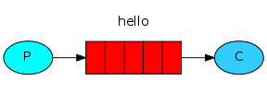
Demo
Simple Background Worker

Slide 10
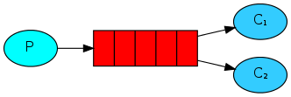
Demo
Scaling Out Background Worker

Slide 11
Pub/Sub
Publisher
Sends out messages about it’s activity (events)
Subscriber(s)
Receive messages and do work

Slide 12
Why Pub/Sub?
Different work that needs to be done when an event completes
Decoupling to allow flexibility
Refresh multiple clients

Slide 13
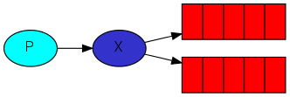
Demo
Pub/Sub – Fanout Exchange

Slide 14
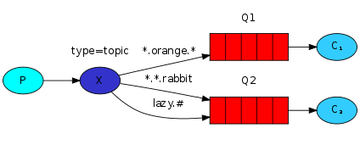
Demo
Pub/Sub – Topic Exchange

Slide 15
“Good” Practices
Have a message versioning strategy
Don’t use messaging/queues for RPC
Create a meaningful hierarchy for your topics
Ex: <company name>.<application name>.<concern>.<message purpose>

Slide 16
Recovery and Scaling
Basic – Use Message Acknowledgements
Clustering
Exchanges, Routes, and Users replicate
Queues require more work
More Scaling
Shovel: http://www.rabbitmq.com/shovel.html
Federation: http://www.rabbitmq.com/federation.html

Slide 17
Domain Driven Design
Domain Driven Design – Eric Evans
DDD Quickly (the Cliff Notes)
http://www.infoq.com/minibooks/domain-driven-design-quickly

Slide 18
MassTransit
Documentation
http://docs.masstransit-project.com
Google Groups
http://groups.google.com/group/masstransit-discuss

Slide 19

Questions?

Slide 20
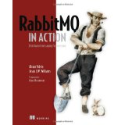
Further Reading
RabbitMQ in Action
Alvaro Videla
Jason Williams

Slide 21
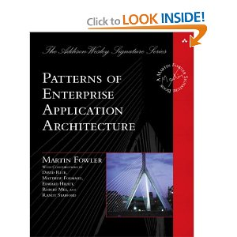
Further Reading
Patterns of Enterprise Application Architecture
Martin Fowler

Slide 22
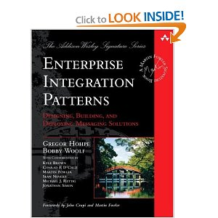
Further Reading
Enterprise Integration Patterns: Designing, Building, and Deploying Messaging Solutions
Gregor Hohpe
Bobby Woolf

Slide 23
Thank You!
Github: https://github.com/ekepes
Twitter: @ekepes
Blog: http://erickepes.com
Email: eric@kepes.net
Demos and Slides:
https://github.com/ekepes/Presentations

